Slide 1
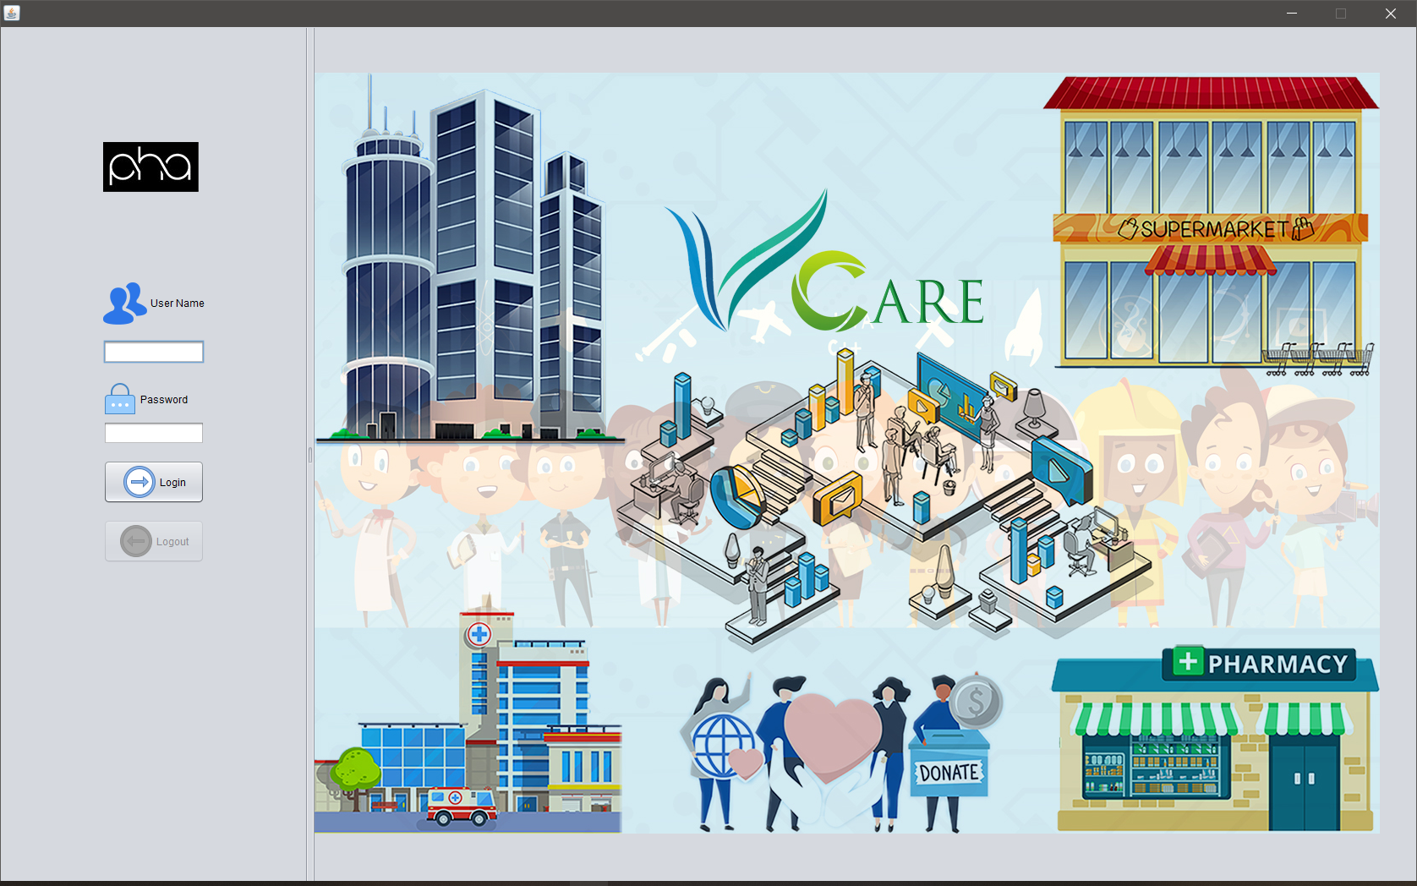

AED Final Project: Next Generation Development
Team : PHA 001375968 Priyank Gala 001306605 Hardik Thakkar 001438598 Apoorva Mishra

Slide 2
Problem Definition
Every developing and underdeveloped Nation face poverty and poverty leads to unemployment, lack of basic facilities like health and education. For the coming generations with changing times its more crucial for them to receive both health and education as technology advancement is reaching its peak and its time, we get rid of these basic issues on a global level. Recent estimates for global poverty are that 8.6 percent of the world, or 736 million people, live in extreme poverty on $1.90 or less a day, according to the World Bank. Due to this underprivileged kids are still devoid of primary education and more than 6 million die/suffer due to the lack of proper treatment, medicines and nutrition.
In this project, we are creating an application that will forge strategic partnerships between Companies, Hospitals and NGO’s where the employees of the respective organizations will be able address the issues stated above increasing the Corporate Social Responsibilities (CSR) of their company and it will also play a key role during their overall development.

Slide 3
Application Key Functionalities
In order to solve this critical problem, we have created a Model that will facilitate communication between 4 enterprises that are in the Network namely : NGO’s, Corporate’s, Grocery Company's and Private Hospital’s. The NGO will have underprivileges kids who seek skill development, food and health treatment. They will create events like educational sessions, and health checkups and sent them respectively to the Corporate’s and Hospital’s organization.
The Corporate employees will take part in this initiative since it will help the company’s CSR score and play a huge role during their appraisal period. The Doctors will join this initiative to execute their knowledge in helping the underprivileged kids who will be relieved from all the diseases they have had.
In the end, the students will be given a test after the Education Workshop to check what they learnt, and a prescription after their Health Checkup to help them in restoring their wellbeing.

Slide 4
Proposed Solution
In order to solve the critical issue and crisis, we have created an application that will facilitate communication between 5 enterprises that are in the Network namely : NGO’s, Corporate’s, Grocery Company’s, Private Hospital’s and Pharmacy. The NGO will have underprivileges kids who seek skill development, food and health treatment. They will create events like educational sessions, and health checkups and sent them respectively to the Corporate’s and Hospital’s organization.
The Corporate employees will take part in this initiative since it will help the company’s CSR score and play a huge role during their appraisal period. The Doctors will join this initiative to execute their knowledge in helping the underprivileged kids who will be relieved from all the diseases they have had.
In the end, the students will be given a test after the Education Workshop to check what they learnt, and a prescription after their Health Checkup to help them in restoring their wellbeing.

Slide 5
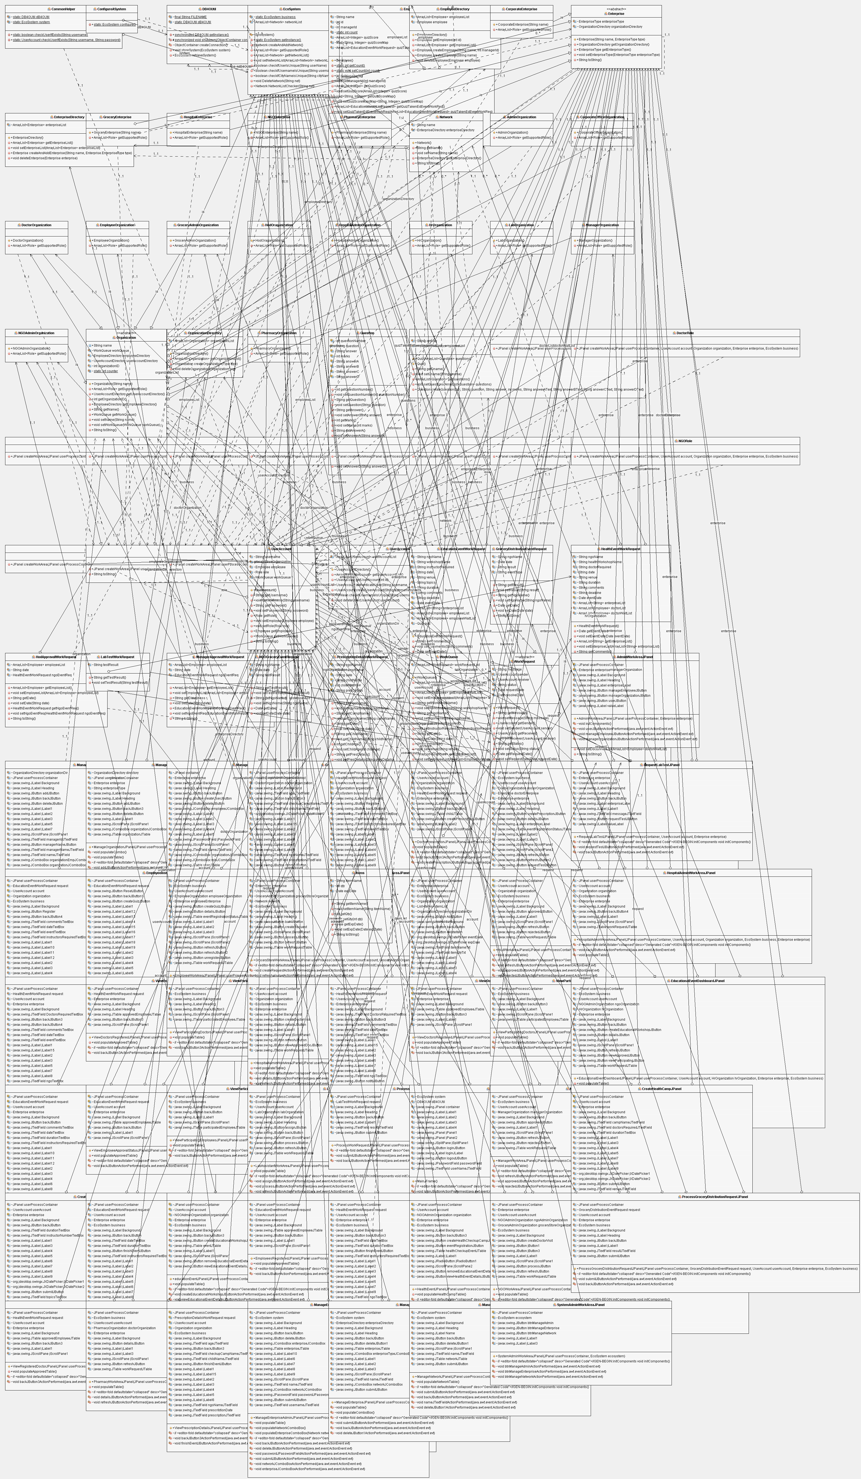
Object Model

Slide 6
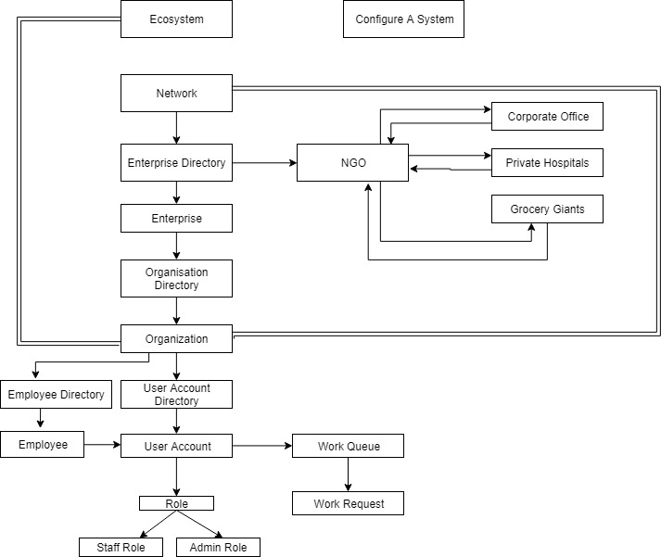
Architecture Diagram

Slide 7
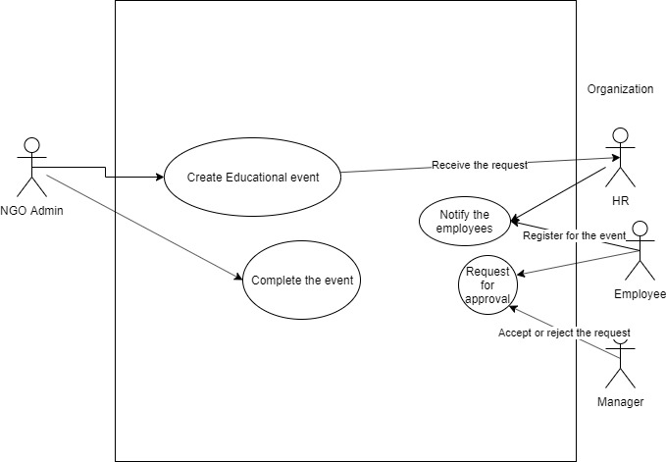
Event 1 Use Case Diagram

Slide 8
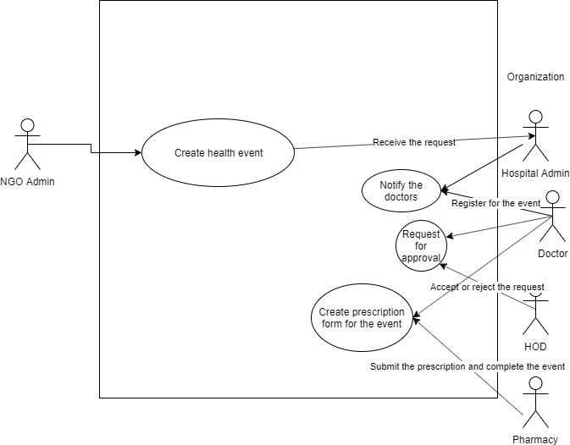
Event 2 Use Case Diagram

Slide 9
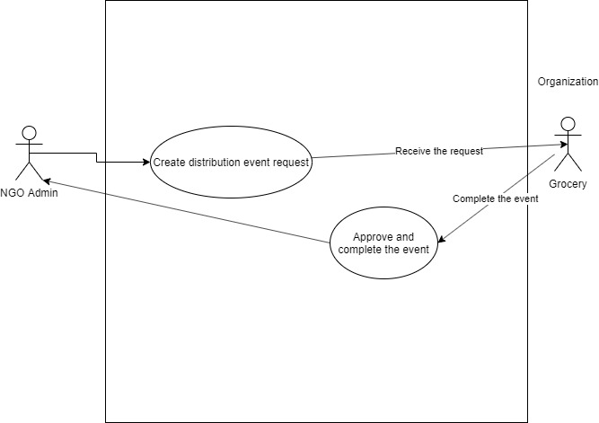
Event 3 Use Case Diagram

Slide 10
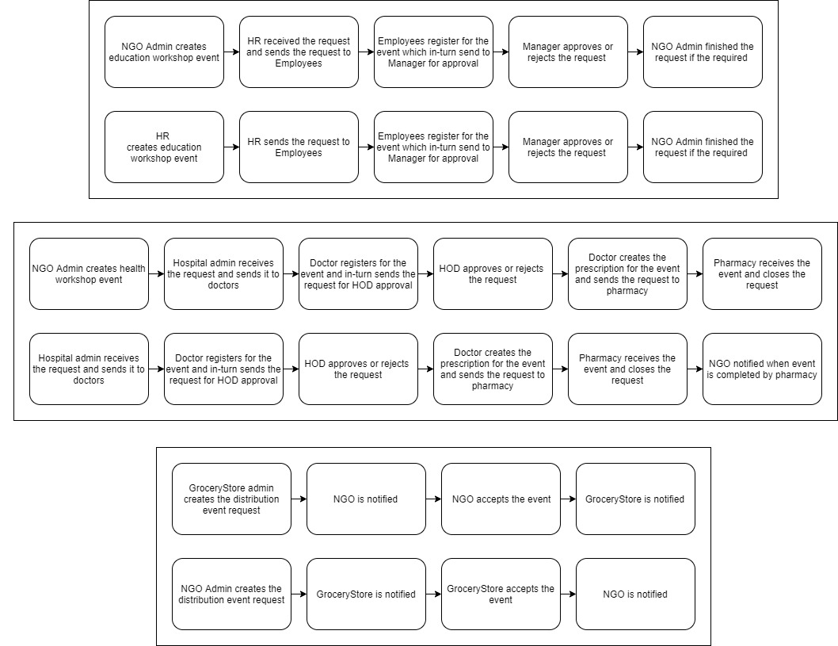
Approach (Workflow)

Slide 11
Screenshots of a few panels of each entity are added to give an idea of look and feel of the application.

Slide 12

Login Page

Slide 13
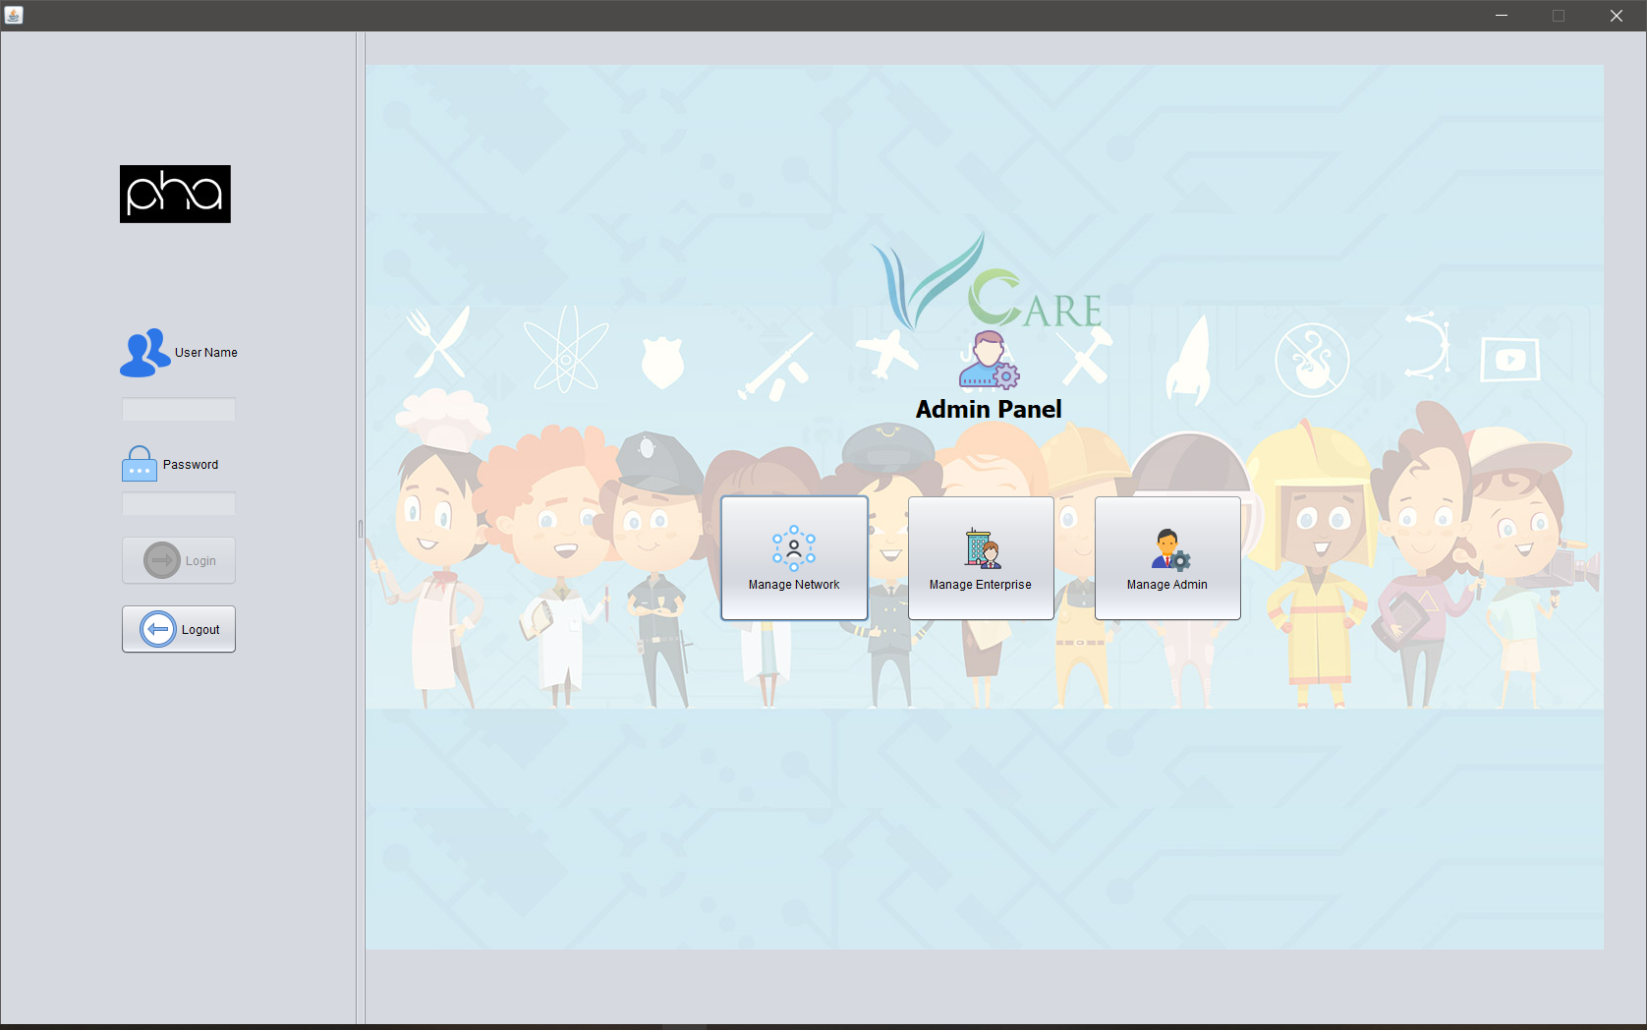
VCare System Admin Panel

Slide 14
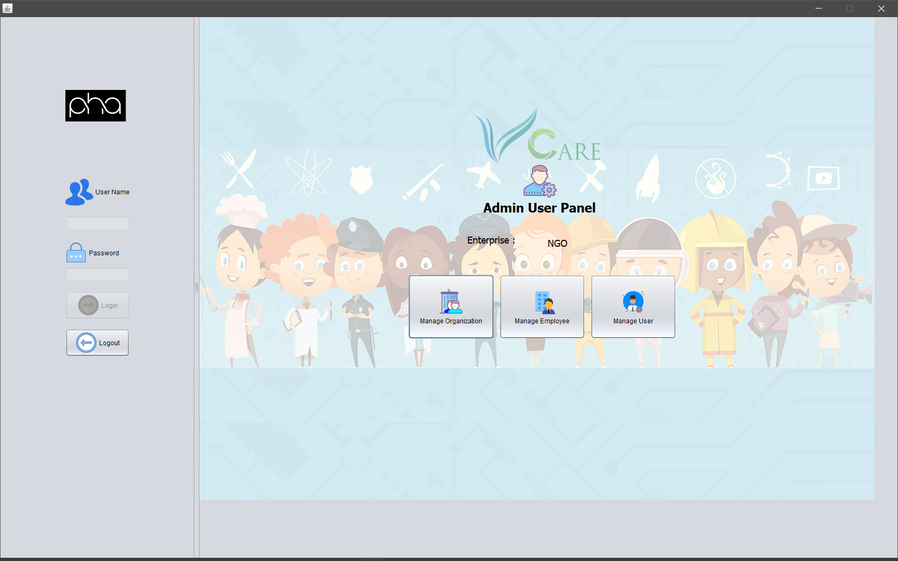
NGO Entity Admin Panel

Slide 15
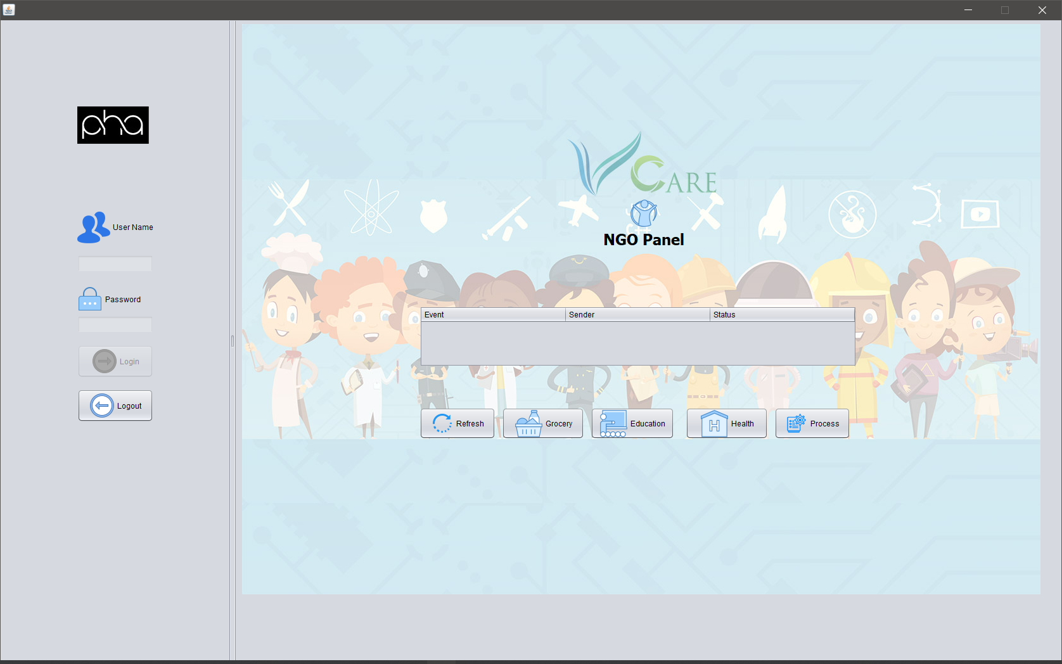
NGO User Panel

Slide 16

Corporate Entity Admin Panel

Slide 17
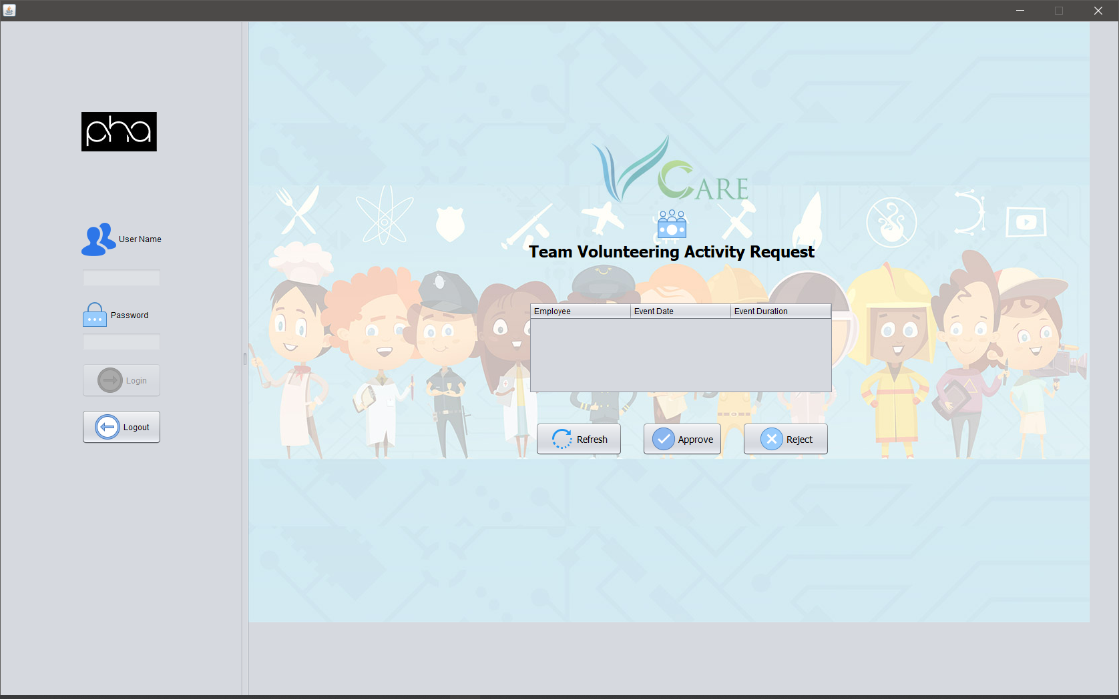
Corporate Manager User Panel

Slide 18
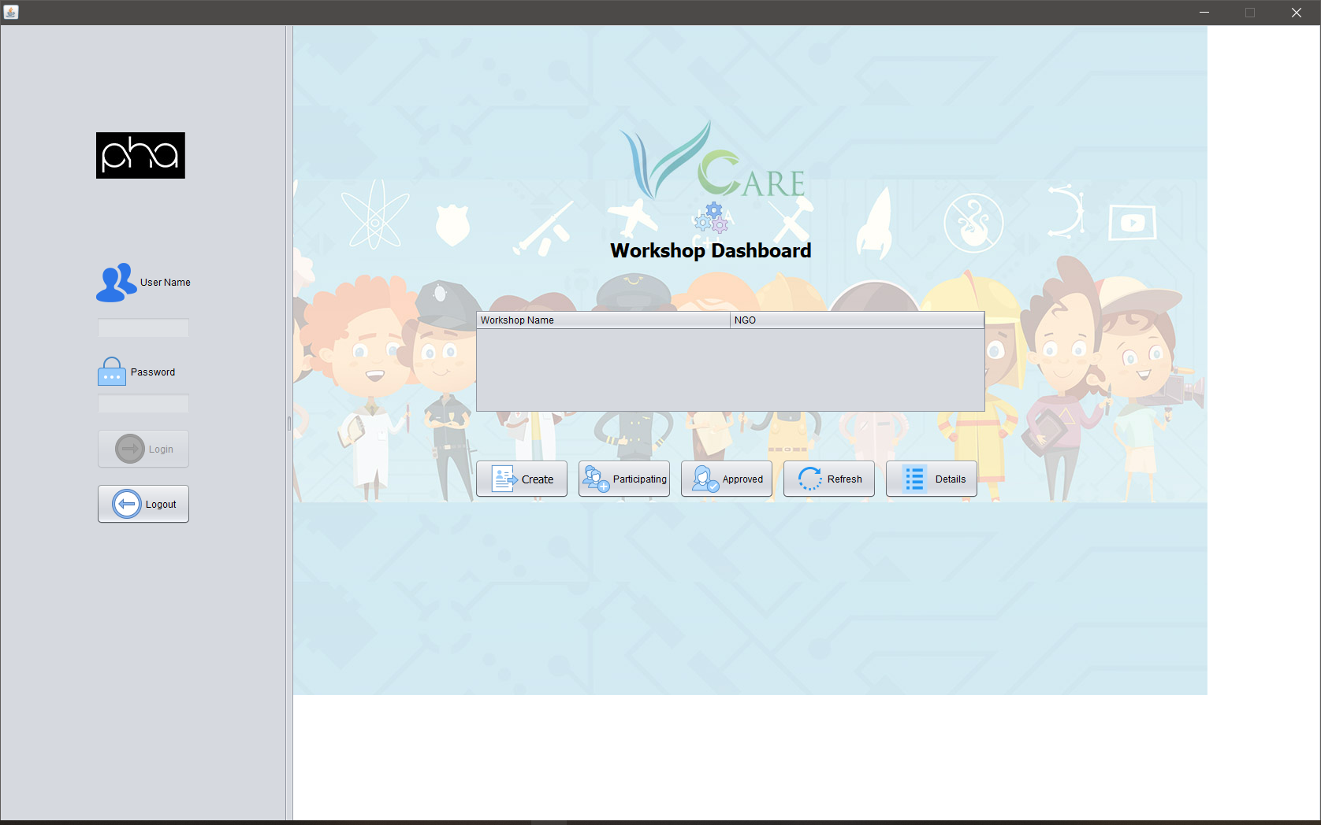
Corporate HR User Panel

Slide 19
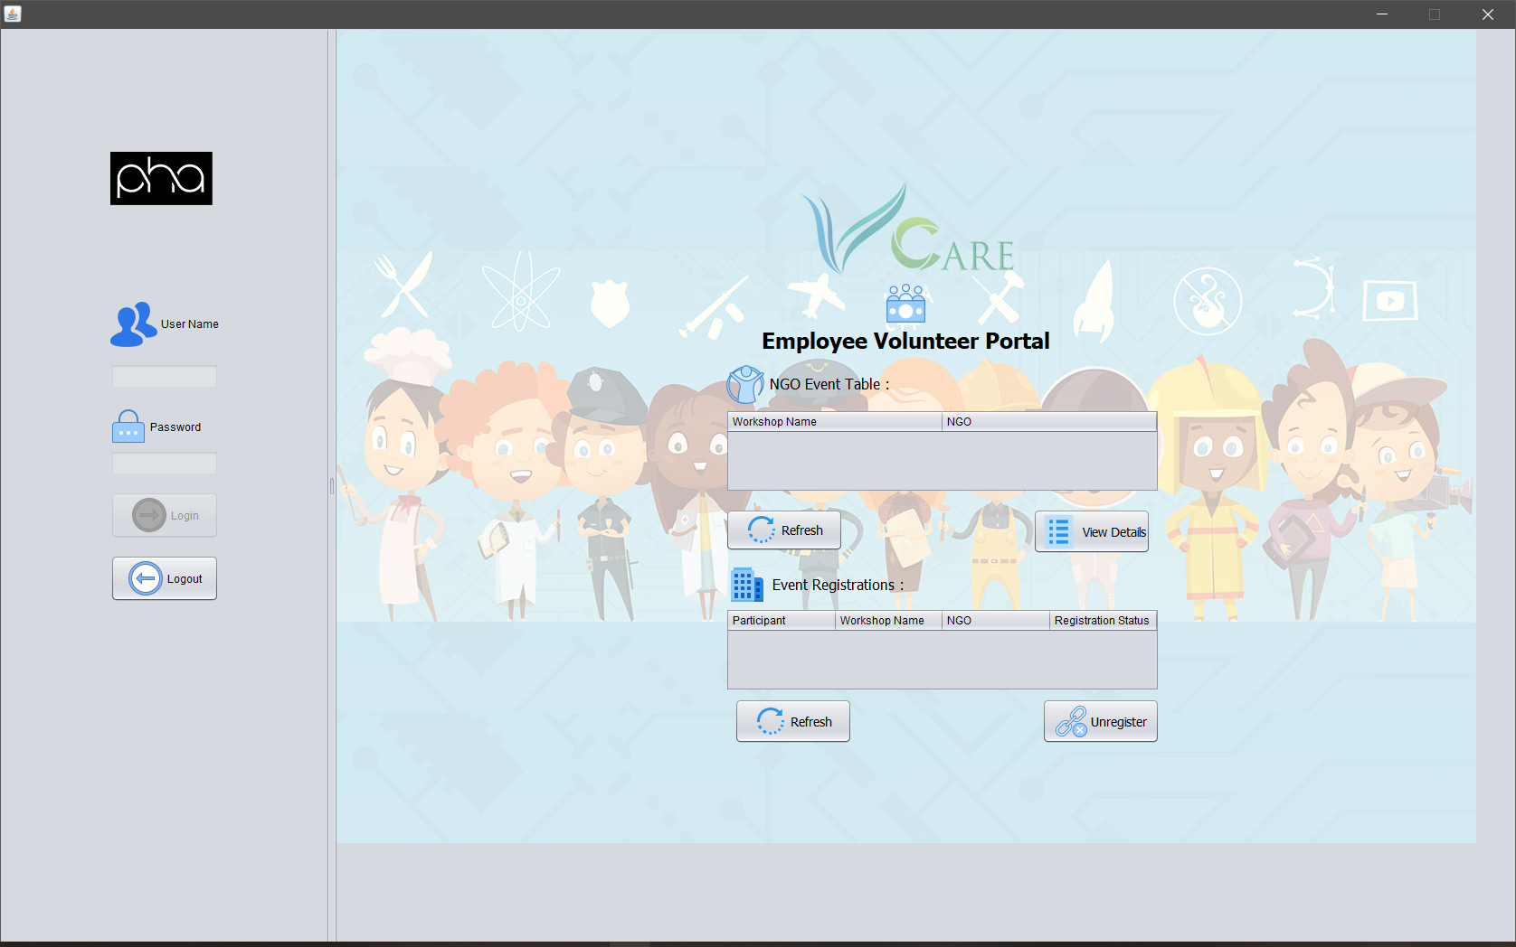
Corporate Employee User Panel

Slide 20

Grocery Entity Admin Panel

Slide 21
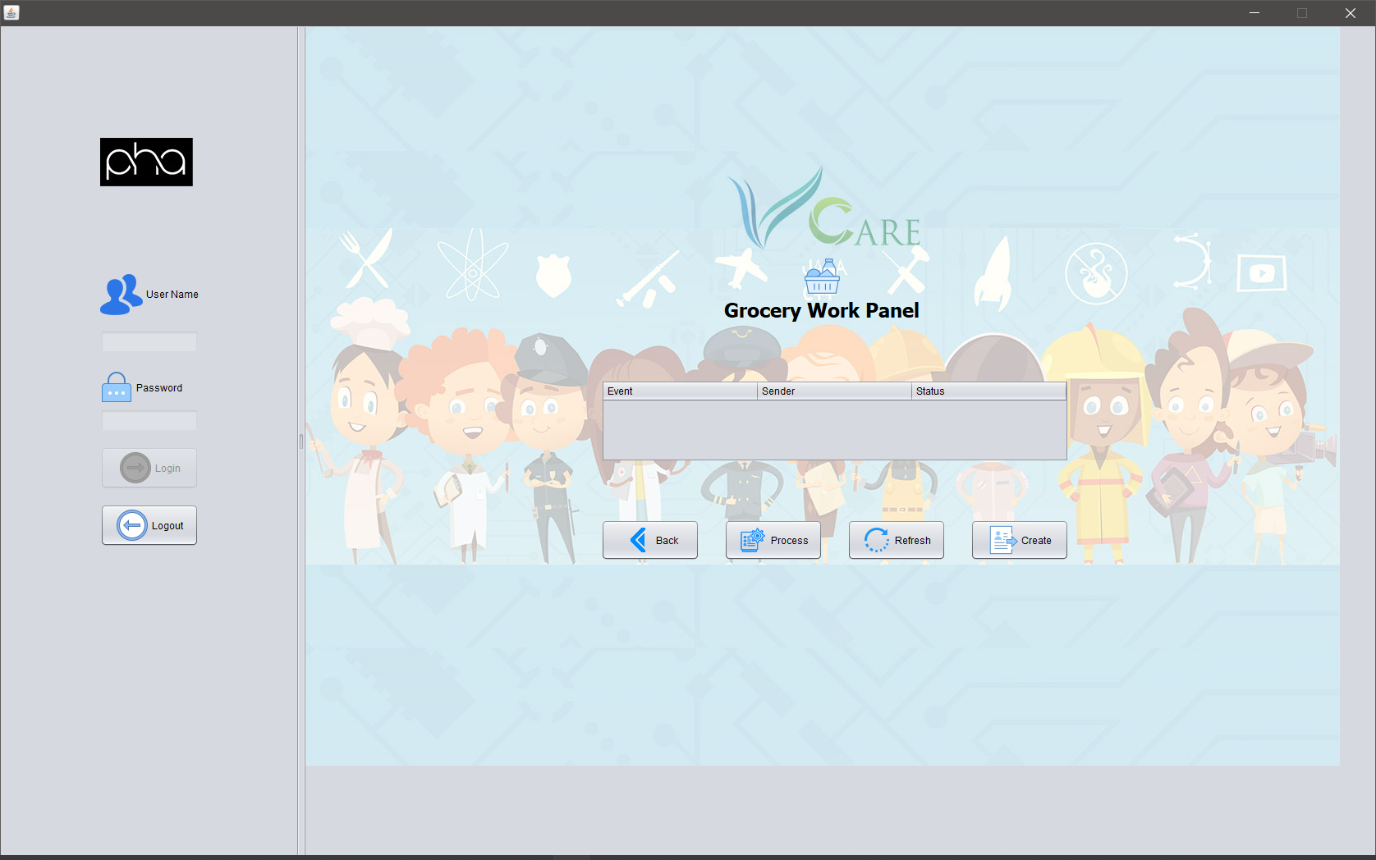
Grocery User Panel

Slide 22

Hospital Entity Admin Panel

Slide 23
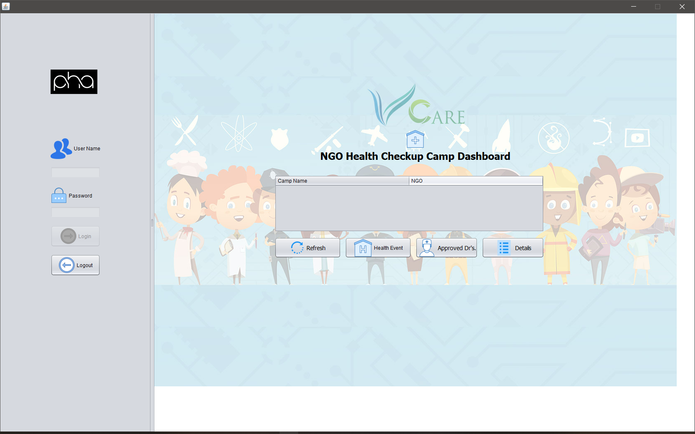
Hospital User Panel

Slide 24

Pharmacy Entity Admin Panel

Slide 25
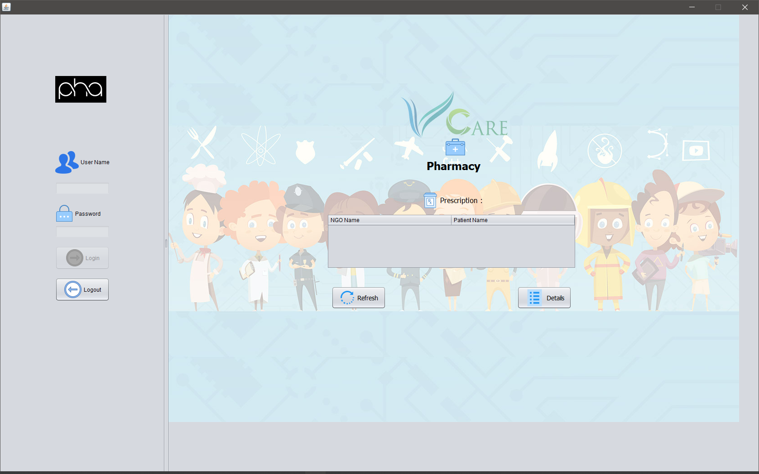
Pharmacy User Panel

Slide 26
Application Demo
Let’s do a quick demo of the solution that we have designed for the issue quoted and have a better insight of the application that will leverage the use of technology to have work exchange between our all five entities.

